Slide 1

Data Types

Slide 2

Exam Objectives
Using Operators and Decision Constructs
Declare and initialize variables (including casting and promoting primitive data types
Identify the scope of variable.
Use local variable type inference

Slide 3
Data & Types
A program is nothing but an exercise in manipulating the data represented by variables and objects.
In order to work with data, every language defines certain basic data types.
Java defines primitive data types :
byte
short
char
int
float
double
boolean

Slide 4
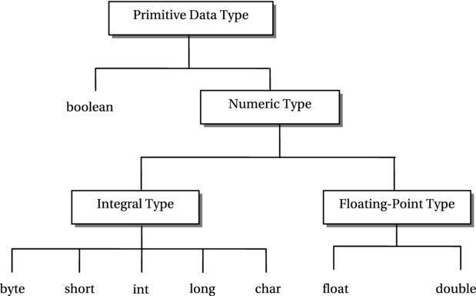
Package

Slide 5
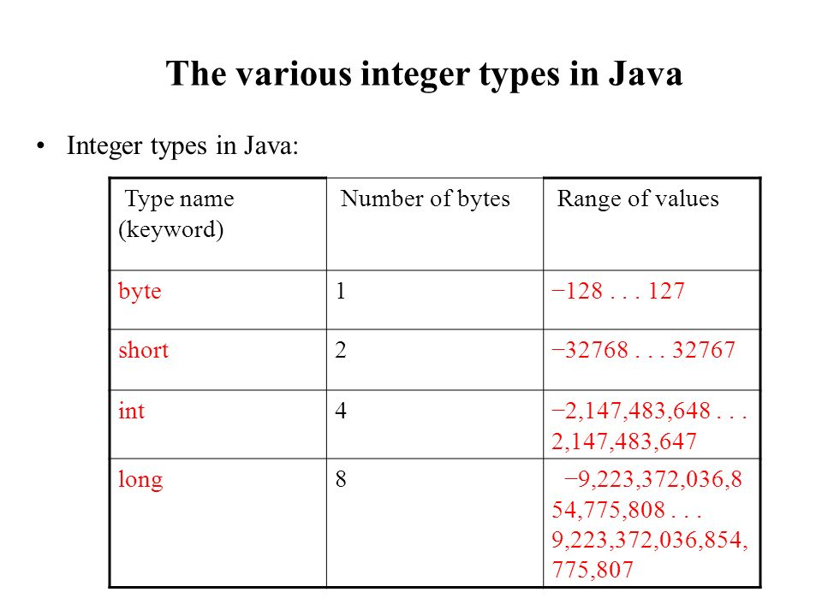
Integral Data Types
Integral values are represented as signed two’s compliment except for character values.
Good to know but not required for exam.
byte
short
char (unsigned)
int
long

Slide 6
Char : A special case.

Slide 7
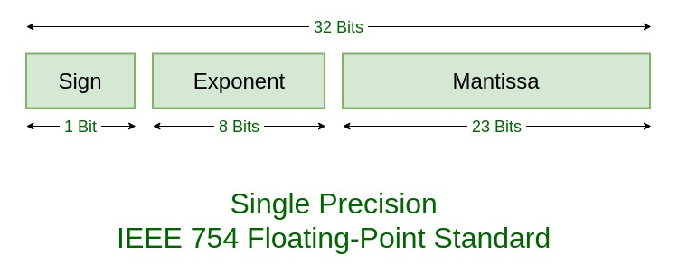
Floating Data Types
Java follows IEEE-754 standard for representation of floating point numbers.
Good to know but not required for exam
float
double

Slide 8

Boolean Data type
A Boolean data type represent value in the form of:
true
False
It majorly used while taking decision and testing for a certain value to be true or false.

Slide 9
Class : Complex Data types
Complex types are those that are built using the basic primitive data types in java.
A class defines data type which can combine one or more primitive data types or more complex data types.

Slide 10

Java File/Class Naming
Example : Postal addressing system

Slide 11

Entry Point to the World of JAVA : Main Method
Serves as an entry point to any java program. Almost all java programs whether it be a web server written in java or a web application or a desktop application , all begin with a main method and then extend further.
Just like a VISA document acts like an entry point to any country and you need to satisfy all the conditions in order to possess one similar is the case with main method in java.
Source Example : org.java.entrypoint.EntryPoint.java

Slide 12

Exam Perspective
We could see in the real exam , questions on a valid way of writing the entry point main method.
There are several incorrect ways of writing the entry point program.
In the exam there will be often be a case when the main method is not given.In those cases we nened to assume the presence of a hidden main method.

Slide 13
Command Line Arguments
While running a java program we can pass on some input to the program.
Java reads this input in a String array.
Ways of passing command lines :
a b c
a b c
“a ” b c
In case of no arguments an array of zero size is passed.
Example : You want to write a program to display contents of a file that runner of the program wants.The runner of the program would just pass the name of the file that he wants to be displayed on command line and the program would display it.
a b c
a b c

Slide 14
Compiling & Running
In the beginning it is important to understand the semantics of running a java program from command line.
Refrain from using any IDE for some time.
Javac & java are the two tools that JDK provides to compile and execute your program respectively.
javac WelcomeToJava.java creates WelcomeToJava.class file.
Java WelcomeToJava runs the program.
Package declaration is not just a logical segregation but physical also.
Format for running a java program : java <packageName>.<MainClassName>
a b c

Slide 15

Questions ??
a b c

